Slide 1
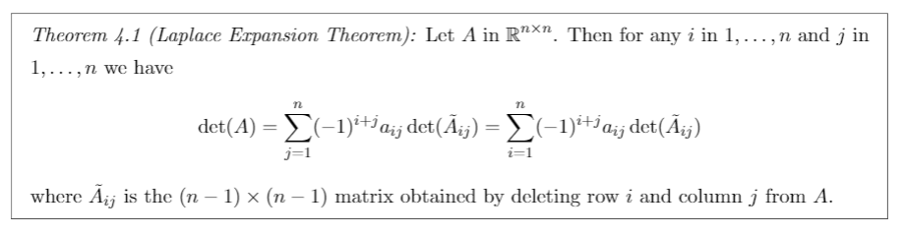
Laplace Expansion Theorem

Slide 2
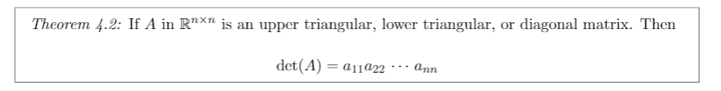
Determinant of Diagonal Types

Slide 3
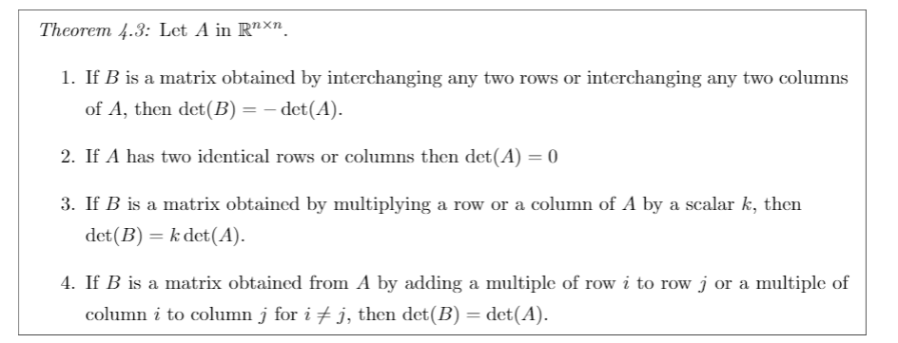
Determinant Row/Col Properties

Slide 4
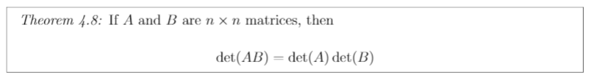
Product of 2 Determinants

Slide 5
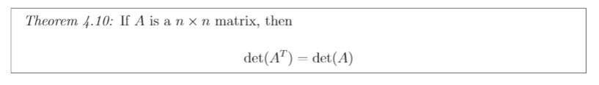
Transpose of a Determinant

Slide 6
Invertible Determinant

Slide 7
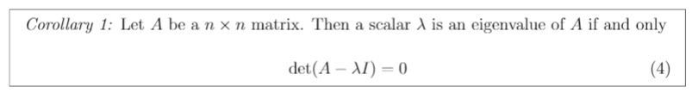
Finding Eigenvalues

Slide 8
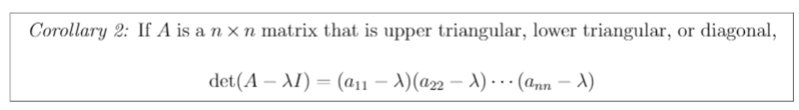
Eigenvalues of Diagonal Types

Slide 9
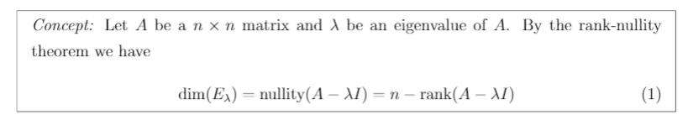
Geometric Mult Shortcut

Slide 10
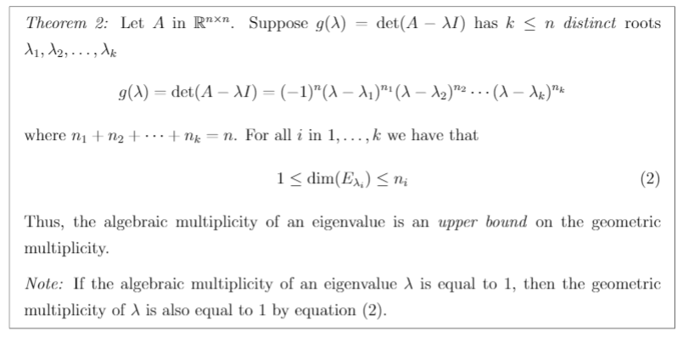
Geometric Mult Bound

Slide 11

Invertible Eigenvalue

Slide 12
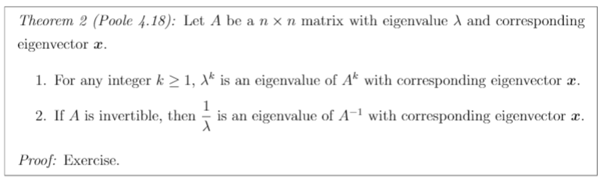
Manipulated Matrices Eigens

Slide 13
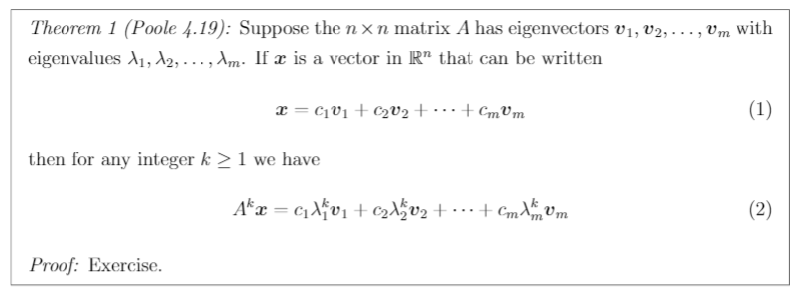
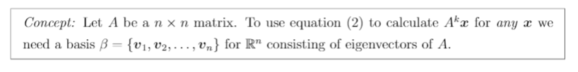
Matrix Powers Calculation

Slide 14
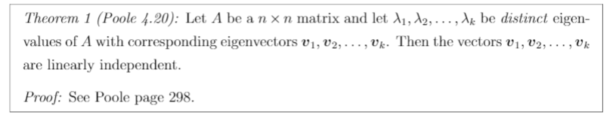
Linearly Indep & Distinct Eigens

Slide 15
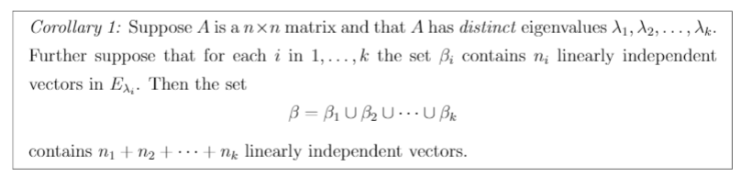
Linearly Indep Set of Eigenvectors

Slide 16
Matrix & Diagonal Matrix Powers

Slide 17
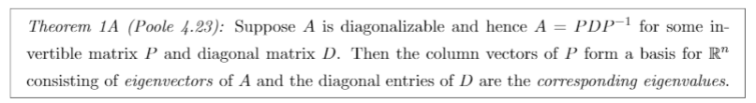
Finding P Matrix

Slide 18
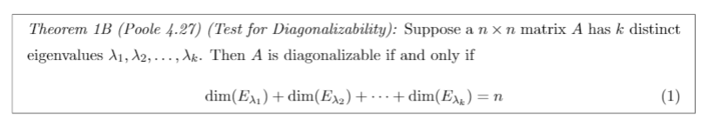
Test for Diagonalizability

Slide 19
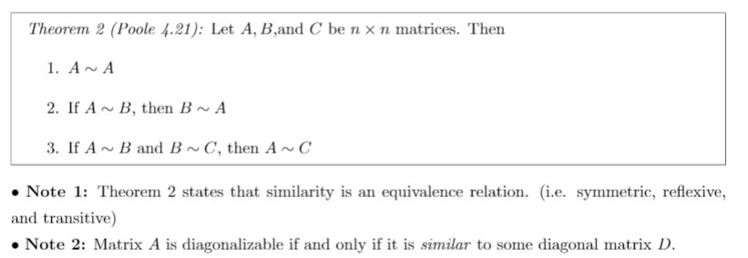
Similar Matrix Properties 1

Slide 20
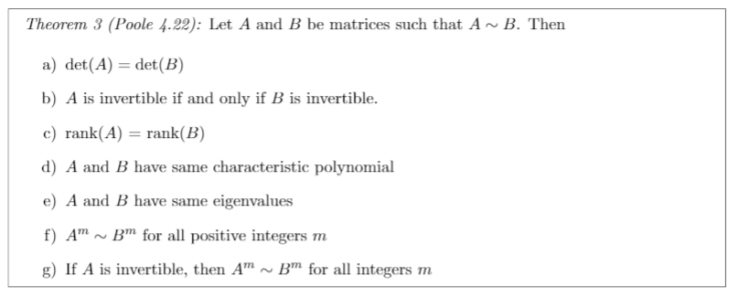
Similar Matrix Properties 2

Slide 21
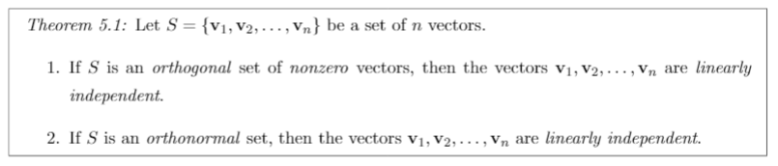
Linear Independent Ortho Sets

Slide 22
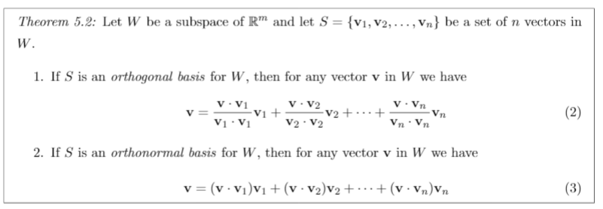
Finding Ortho basis

Slide 23
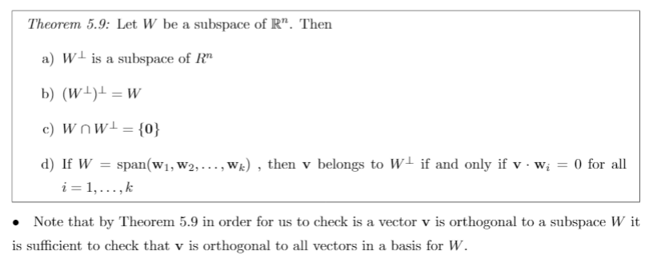
Orthogonal Complement Properties

Slide 24

Orthogonal Complement Vector

Slide 25
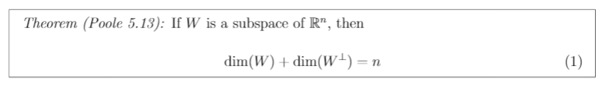
Property of Dimensions

Slide 26
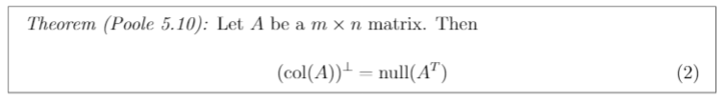
Orthogonal Complement Formula

Slide 27
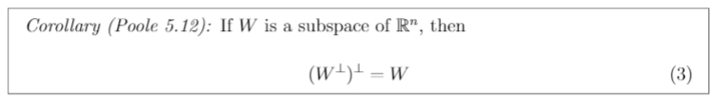
Double Complement Formula

Slide 28
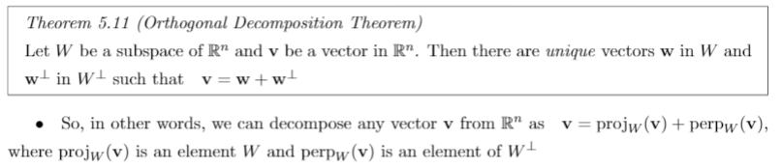
Orthogonal Decomposition

Slide 29
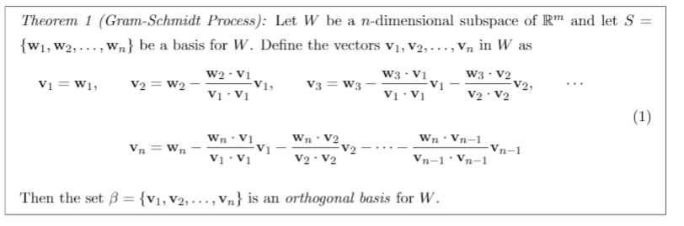
Gram-Schmidt

Slide 30
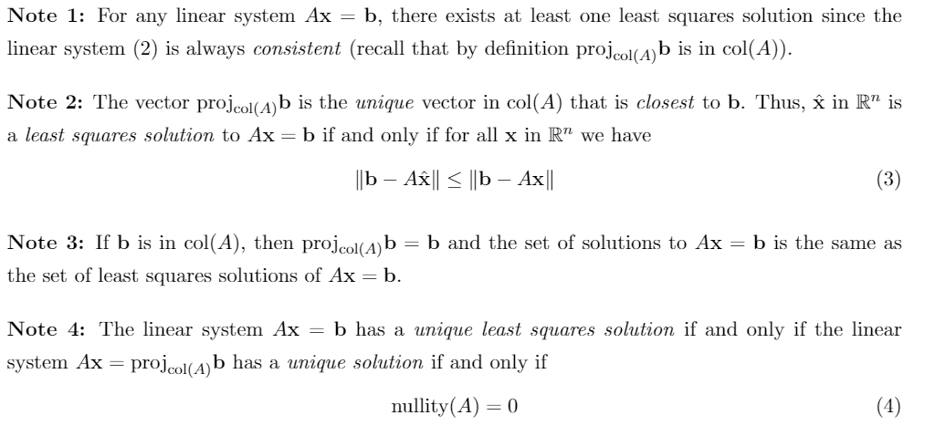
Least Squares Solution

Slide 31
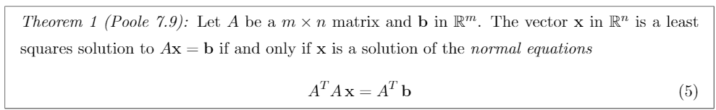
Least Squares Solution Condition

Slide 32
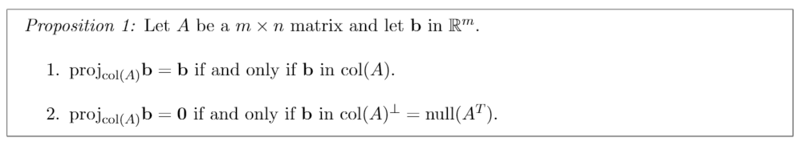
Identity and Zero Projections
Notes:
Optional on modules but on HW 21

